Slide 1

Please enjoy
the music while
we wait for others
Fun Fact: Scott and Seth Avett are from Concord, NC. Click the link to take you to the YouTube Video.
to join ☺
Avett Brothers - The Ballad of Love and Hate

Slide 2

MDM
COLLABORATION
MEETING
March 10th Facilitator will be Mary
March 3rd, 2021

Slide 3

Jennifer
Reminder for CELEBRATE email
Q1 Recognitions
Mindy
Continuation from Q1 Meeting – Courageous Conversations
Dee
Green Day 3/17

Slide 4

CONGRATULATIONS!
Tiara Coleman
Selected by her peers
in the MDM Department
to be Employee of the Month for
March 2021

Slide 5
Accountability, Consistency, and Supportiveness.
“Tiara is committed to teamwork. She jumps in and helps out and shares her knowledge with others to always make sure we are moving in a positive direction.”
“Tiara is always available for an impromptu training sessions. Most recently on the AML's. Her expertise makes working in PLM easier.”
“Tiara is always available and ready to be part of the team and assist when the team is in need of help.”
“Tiara is such a shining star. She engages in discussions and she is not afraid to share her opinion or view, or ask additional questions, which is refreshing and often will highlight points that may not have been previously considered. Her demeanor is positive and determined and her growth over the past year has been evident in her work and work approach. Keep shining!”

Slide 6


Honorable Mentions
Tiah
Kim
Levette

Slide 7
Yearly Summery – this text used for hyperlink – don’t delete
OUR PURPOSE HONOR GOD IN ALL WE DO
SERVE
Develop servant leaders, cultivate a team culture that aligns with our purpose
01
01
02
GROW
Provide strategic and operational oversight to the company’s data and digital assets
02
Data and Digital Vision
Be the catalyst for transforming Coke Consolidated by:
Designing, maintaining, and governing CCCI’s master data assets with the quality, consistency, speed, and efficiencies that enables successful operational execution, decision management, and innovation.
PURSUE
Deliver operational excellence
03
03
GROW
Enable continuous improvement and innovation
04
04
05
PURSUE
Lead the Coke system
05
Notes:
mindy

Slide 8




















Skills Analysis – this text used for hyperlink – don’t delete
2021 Goals
We can only make the right data-driven decisions if the data that we use is correct.
GROW
Continuous Improvement
SERVE
Develop Our People
PURSUE
Operational Excellence
INNOVATION
EDUCATION
SLAs
DATA CLEANSING
CUSTOMER SERVICE
RELATIONSHIPS
LEADERSHIP
PROJECTS
DATA GOVERNANCE
RULE GOVERNANCE
CAREER PATHING
RULE EXECUTION
DATA STANDARDS
BI BEST PRACTICES
PULSE ACTION PLANS
DATA WAREHOUSE
BI DATA GOVERNANCE
DEPARTMENT OBJECTIVES
Support and empower our company with a Master Data asset
ONE trusted source of the truth
Provide governance through a thoughtful educational and metric strategy
1
2
3
Notes:
Bryan & Tammy

Slide 9
Organization – this text used for hyperlink – don’t delete
Original 2021 Focus
Recommended 2021 Focus
The Pulse &
Courageous Conversations
Pulse Engagement Results
The team has a 98.3% engagement rating
We are proud to work at Coke Consolidated!
Pulse Highest Favorability
Revisit 2021 Pulse Focus
Senior Leaders are visible
My accomplishments are recognized
Overall, my job meets my expectations
My manager models are values
Consolidated is committed to diversity and inclusion
After teammate connections, this does not seem to be a concern the team would like to address in 2021
Recommendation:
Continued focus on employee recognition
Continued focus on career goal identification and tracking
Focus on collaboration and building relationships
Pulse Lowest Favorability
Courageous Conversations
I can achieve my career goals at Consolidated
My workload is reasonable
My manager cares about me as a person
My manager supports a balance of work and personal life
I understand my benefit options
Team Recommended Actions:
Connect with someone not like you
Address situations as they arise, 1:1, forum
Require a diverse talent pipeline
Notes:
Mindy

Slide 10
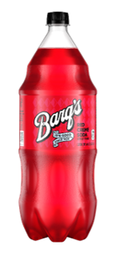
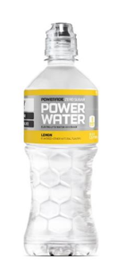







Sales Provisions – this text used for hyperlink – don’t delete
2021 SKU Launch
Results and SLAs for January & February 2021
Total # of Materials
Total # of Extensions
% Execution
93 (5823 Extension to DCs and PCs )
22 (36 in plants)
100%
Notes:
Allen

Slide 11


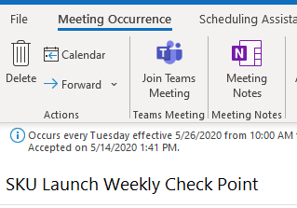
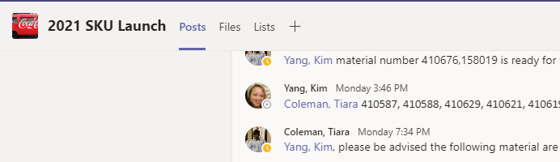


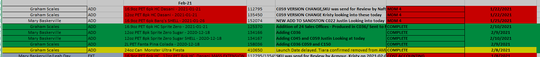
Sales Provisions – this text used for hyperlink – don’t delete
2021 SKU Launch
Teamwork
a
Big THANK YOU
Cross Functional Effort and Collaboration
% Execution
Great Job to all who
Worked to make the 2021
Innovations a success!
What We Improved added new in 2021
Weekly Meeting
With All Workstreams
Utilized Teams Channel for Inter
Tracking, increased communication
And Validation
Graham Scales
Mary Baskerville
Tiara Coleman
Maggie Greene
Sheryl Branch
Kim Yang
Leah Day
Jennifer Holcomb
Allen Spears
Marketing
Procurement
Engineering
Quality
PSP
Cost Accounting
Pricing
Tax Compliance
Approached as a Project- Tracked
Progress, SLA, Risk and Success
Notes:
Allen

Slide 12
Q1 Recognition Thank you!!

Slide 13
Thank you!!
Levette
Managed By Matrix
Hierarchy Form
AR Issues

Slide 14
Thank you!!
Ben
Managed By Matrix
Hierarchy Form
EDI

Slide 15
Thank you!!
Maggie
Decide 4 Action – UPCs
SKU Launch
ZERN Template

Slide 16
Thank you!!
Graham
SKU Launch
Blockchain
PLM Enhancements

Slide 17
Thank you!!
Sheryl
SKU Launch
Reroutes
Freestyle Cleanup

Slide 18
Thank you!!
Tiara
SKU Launch
EDI Portal Enhancements

Slide 19
Thank you!!
Leah
SKU Launch
CCOP Charge Validation

Slide 20
Thank you!!
Kim
SKU Launch
IS Rule Snowflake UAT
Reroutes

Slide 21
Thank you!!
Mary
SKU Launch
PLM Enhancements
Crossroads

Slide 22


Slide 23
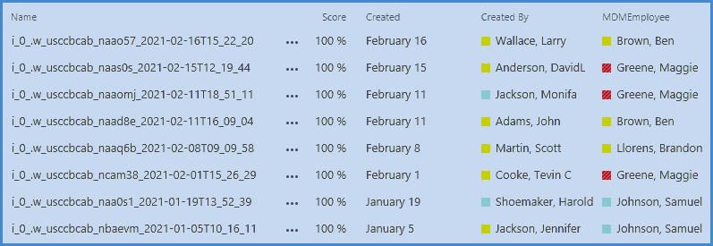


Slide 24
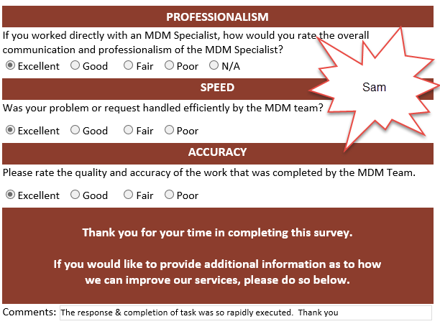

Slide 25
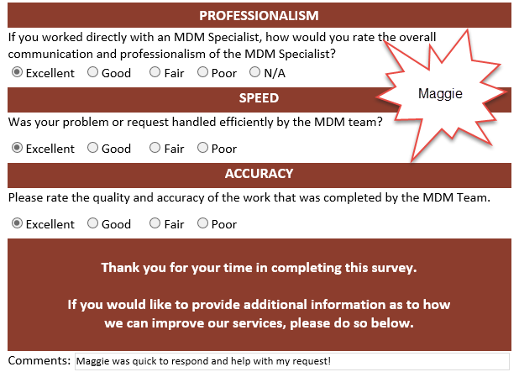

Slide 26
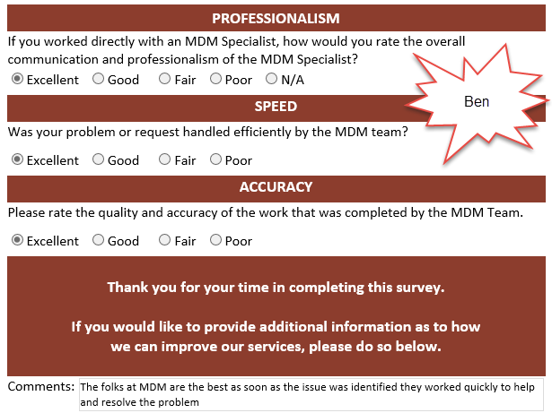

Slide 27
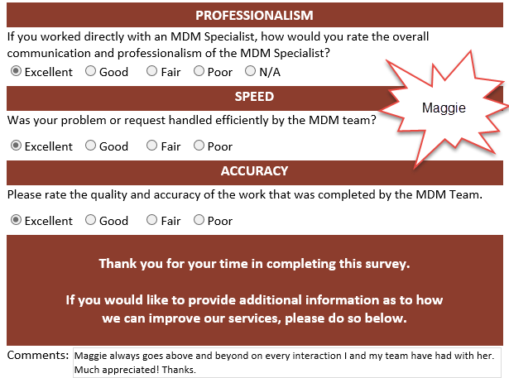

Slide 28
